Slide 1
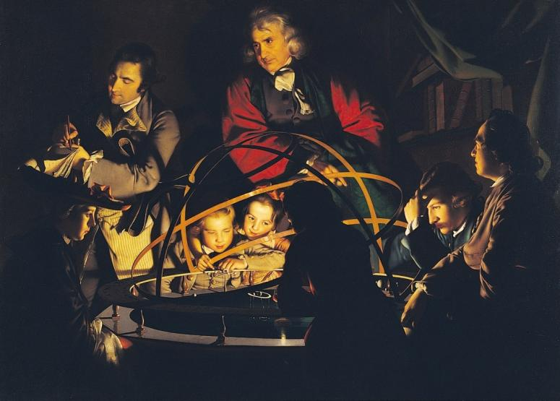
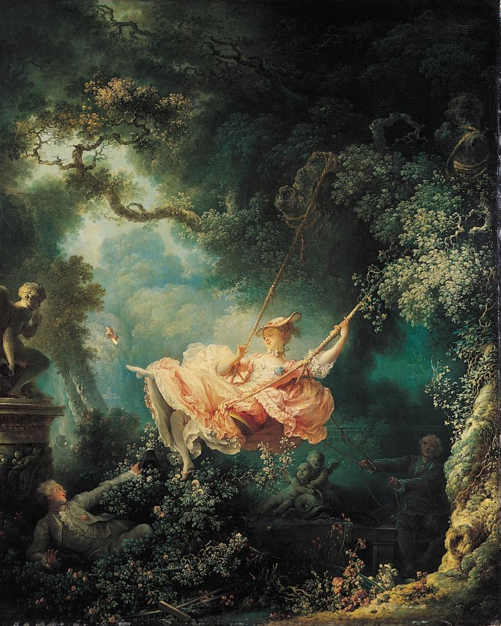
1765
1766
Rococo to Neoclassicism
The 18th Century: A Century of Revolutions

Slide 2
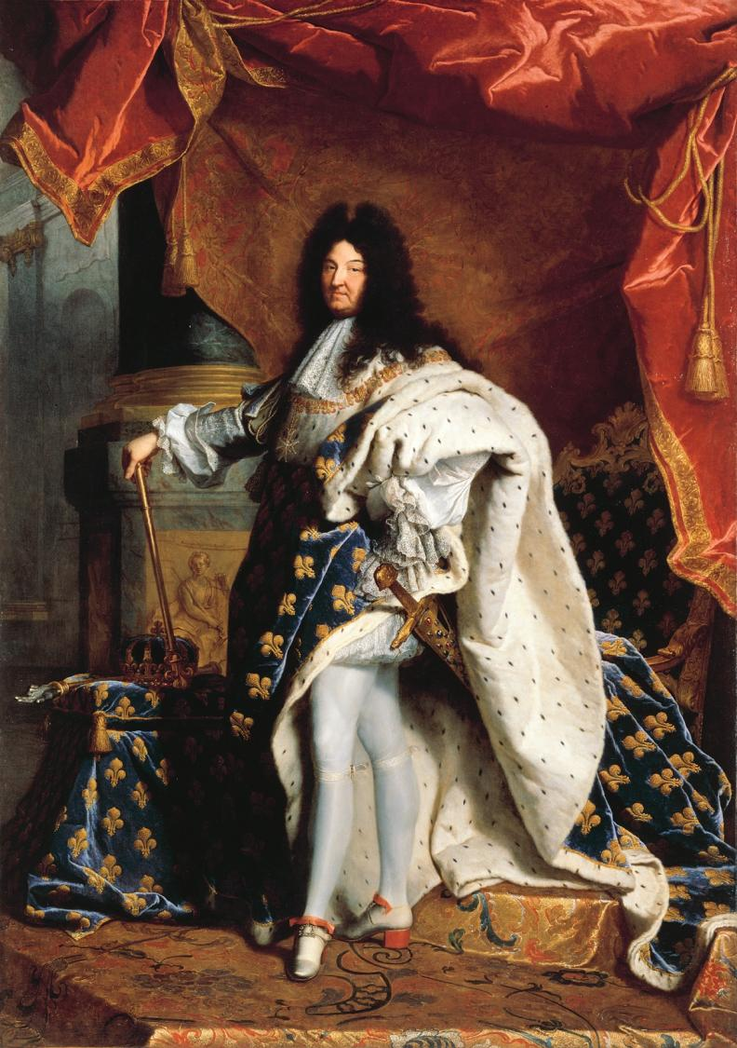
HYACINTHE RIGAUD (French, 1659-1743) Louis XIV, 1701. Oil on canvas, approx. 9’ 2” x 6’ 3”. Louvre, Paris. French Baroque
Art in the service of Absolutism:
Portrait of “The Sun King” Louis XIV
King Louis XIV died in 1715
after the longest reign in European history (1643-1715).
His death marked the beginning of the end of the Baroque era and the feudal system of aristocratic rule in France and Europe. The definitive “end” is the French Revolution of 1789.

Slide 3
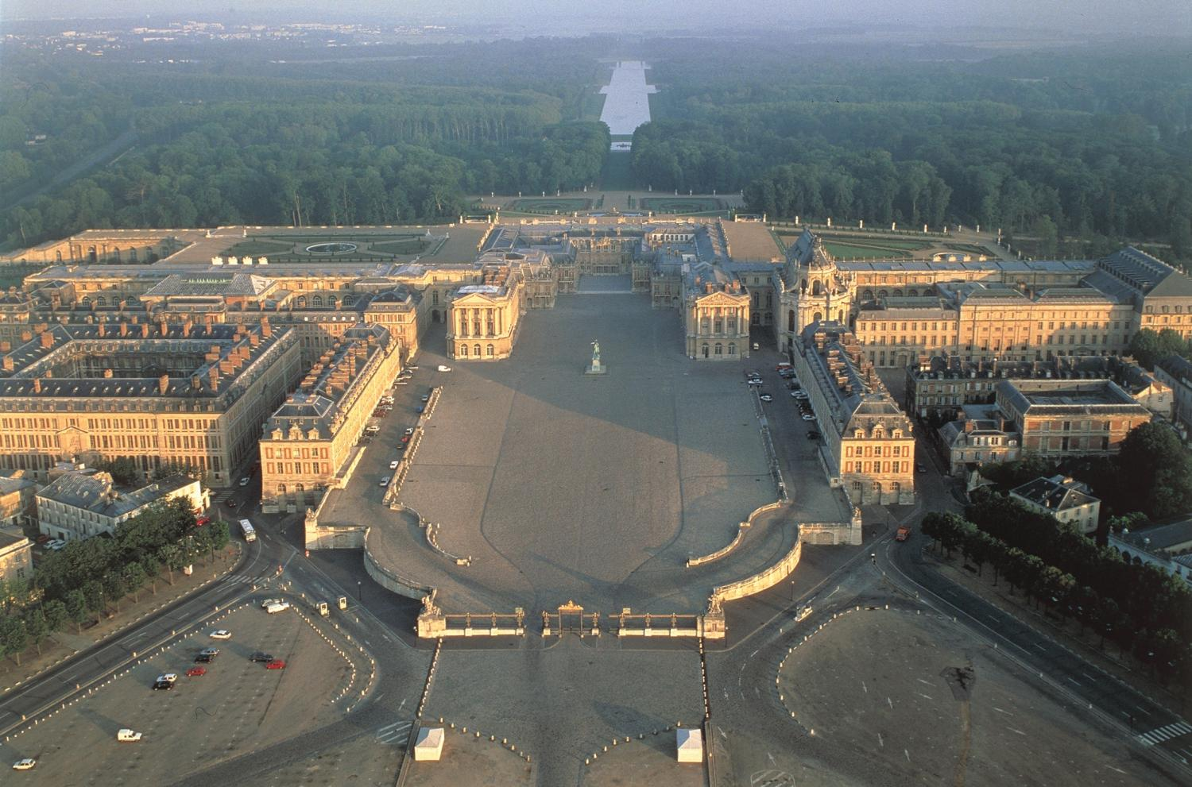
Aerial view of palace at Versailles, France, begun 1669, and a portion of the gardens and surrounding area. French Baroque

Slide 4
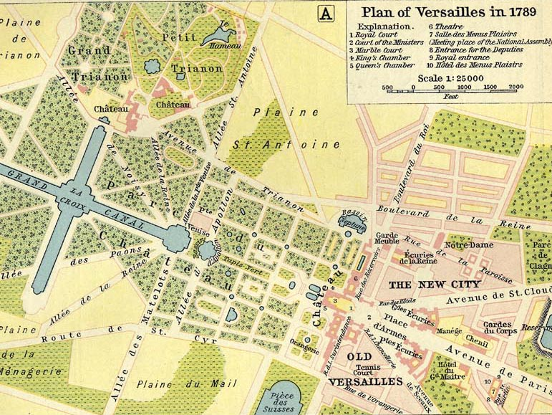

Slide 5
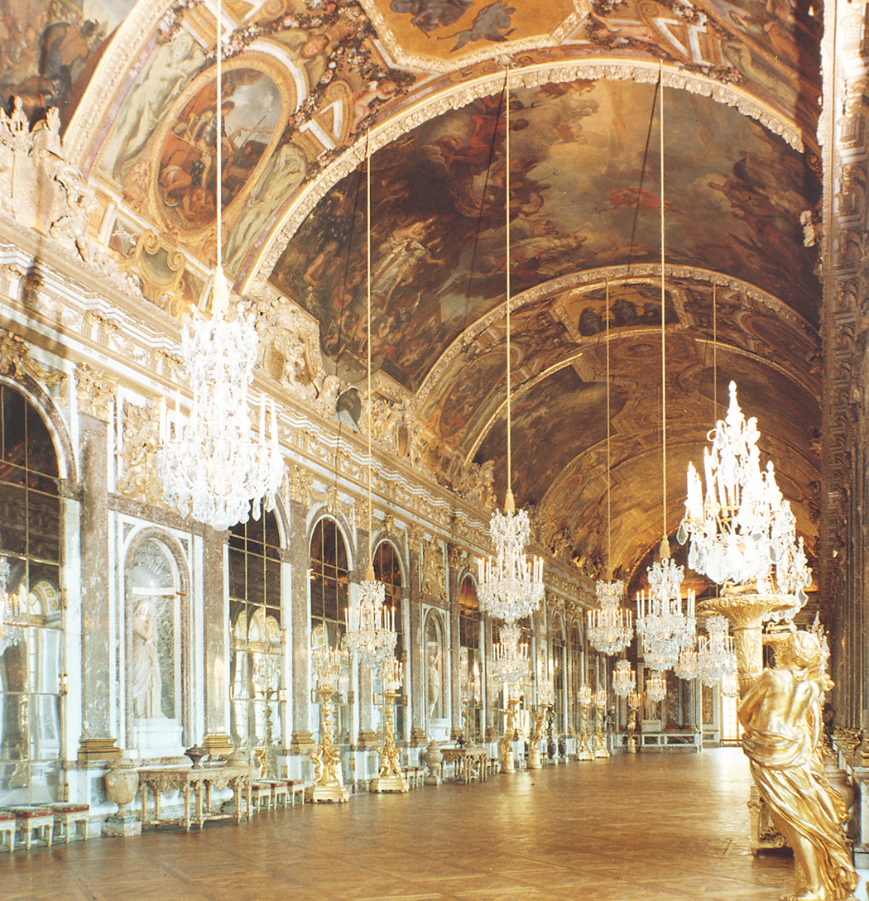
JULES HARDOUIN-MANSART and CHARLES LE BRUN, Galérie des Glaces (Hall of Mirrors), Palace of Versailles Versailles, France, ca. 1680 Baroque period

Slide 6
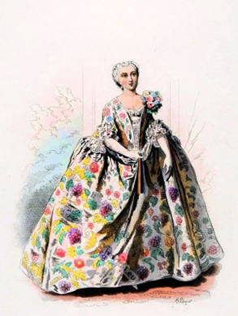
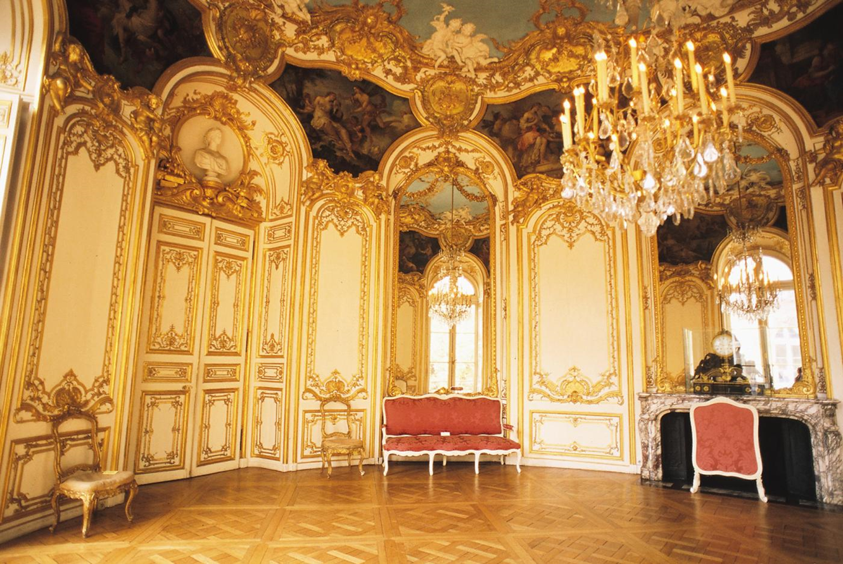
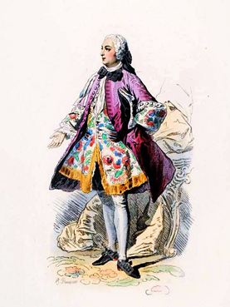
Rococo period, Germain Boffrand (French Rococo architect, 1667-1754) Salon de la Princesse, Hôtel de Soubise, Paris, France, 1737–1740. To get an idea of how this kind of room was used, read “Femmes Savants and Salon Culture,” in your textbook

Slide 7
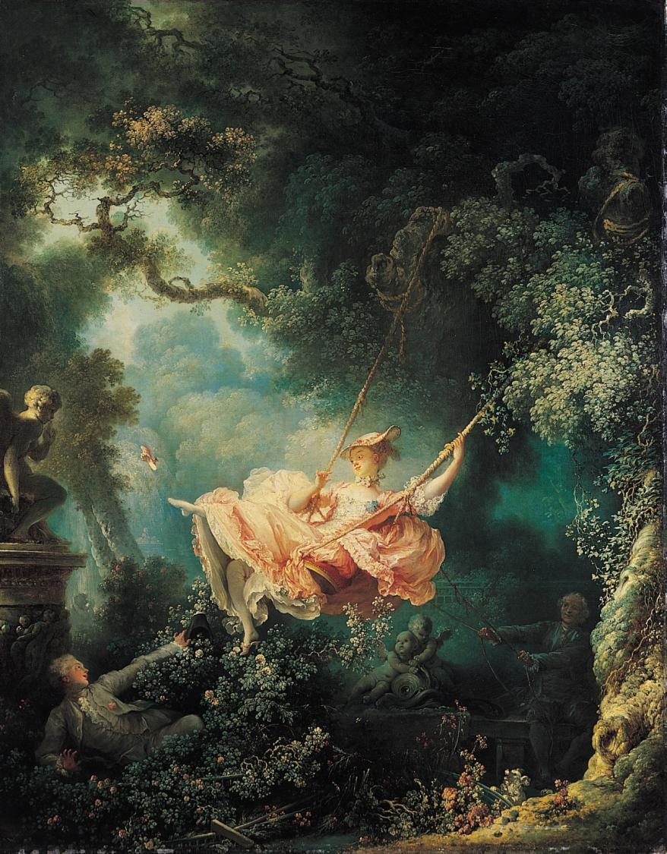
JEAN-HONORÉ FRAGONARD (French, 1732-1806), The Swing, 1766. Oil on canvas, approx. 2’ 11” x 2’ 8”. The Wallace Collection, London. An “intrigue” picture The French Revolution (1789) will deprive Fragonard of his private patrons.

Slide 8
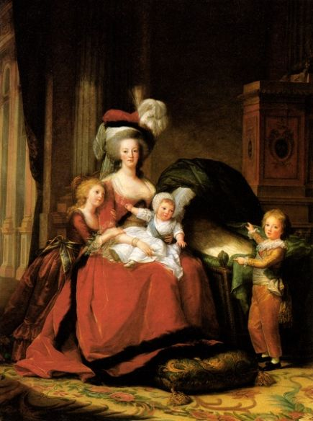
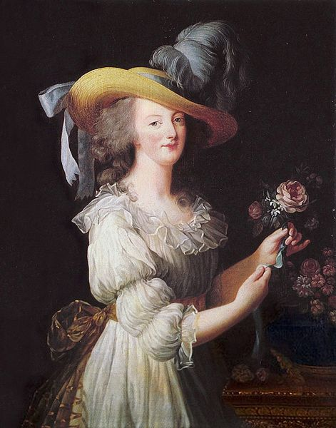
ÉLISABETH VIGÉE-LEBRUN, (left) Marie Antoinette and Her Children, 1787; (right) Portrait of Marie Antoinette, 1783. The subject – the queen of France – was guillotined for treason in 1793

Slide 9
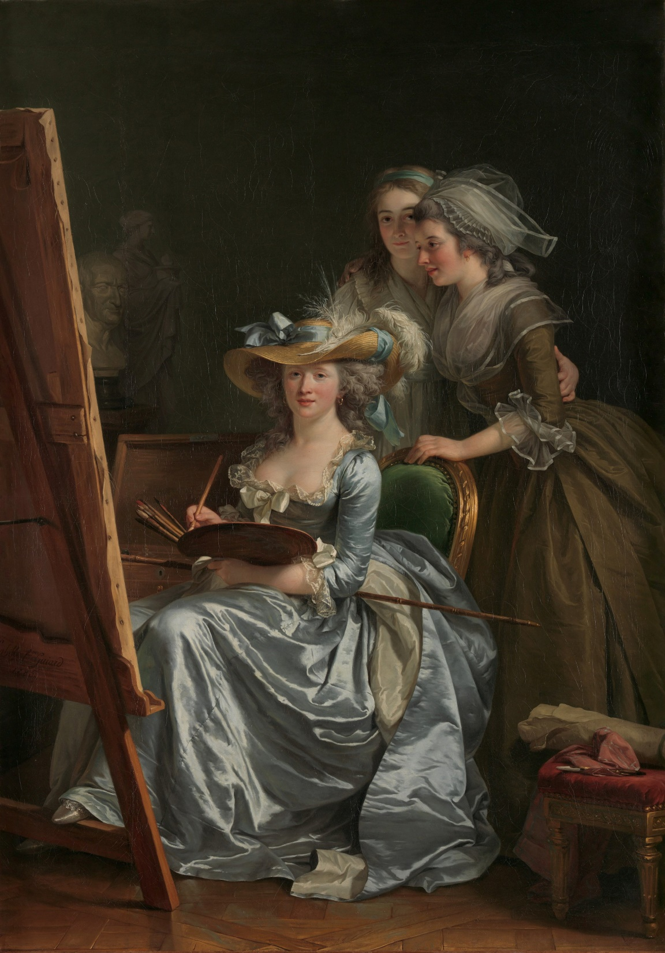
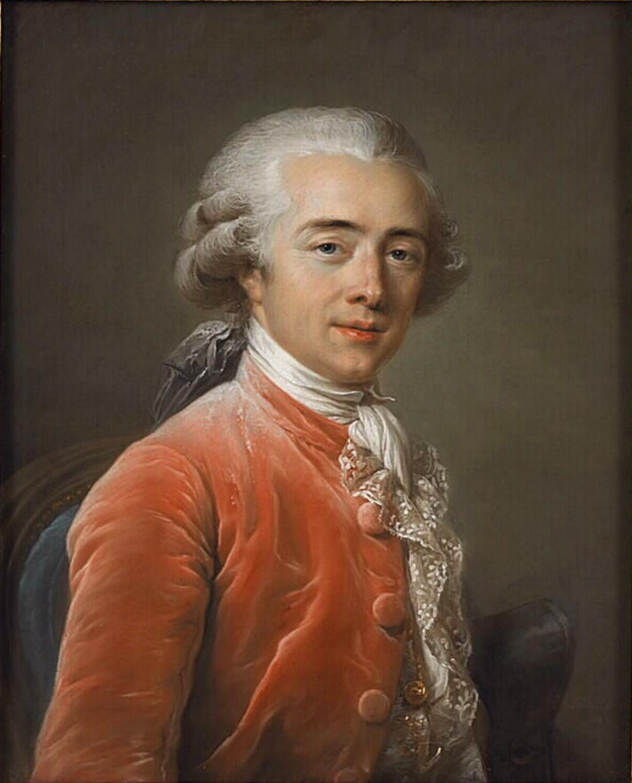
Adélaïde Labille-Girard (French, 1749-1803) Self-Portrait with Two Pupils, 1785, oil on canvas, 6’11” x 4’ 11” Metropolitan Museum of Art, New York
Portrait of François-André Vincent, painted in 1783 by Labille-Guiard, Musée du Louvre. They married in 1800.

Slide 10
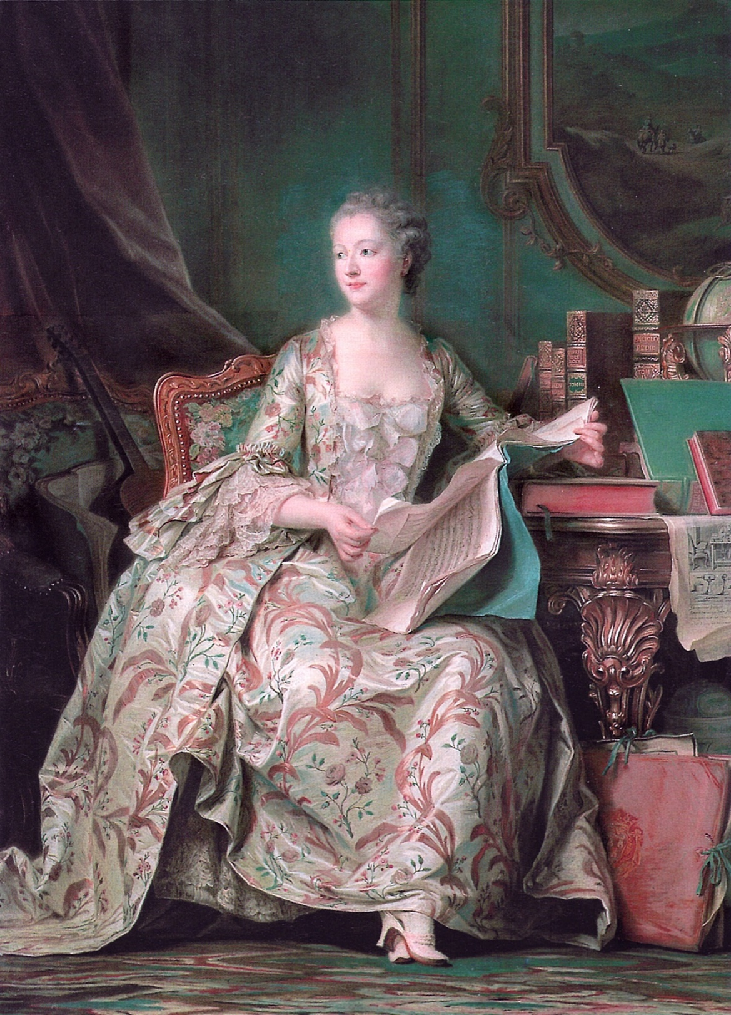
Madame de Pompadour, pastel by Maurice Quentin de La Tour, shown at the Paris Salon, 1755 (Louvre)

Slide 11
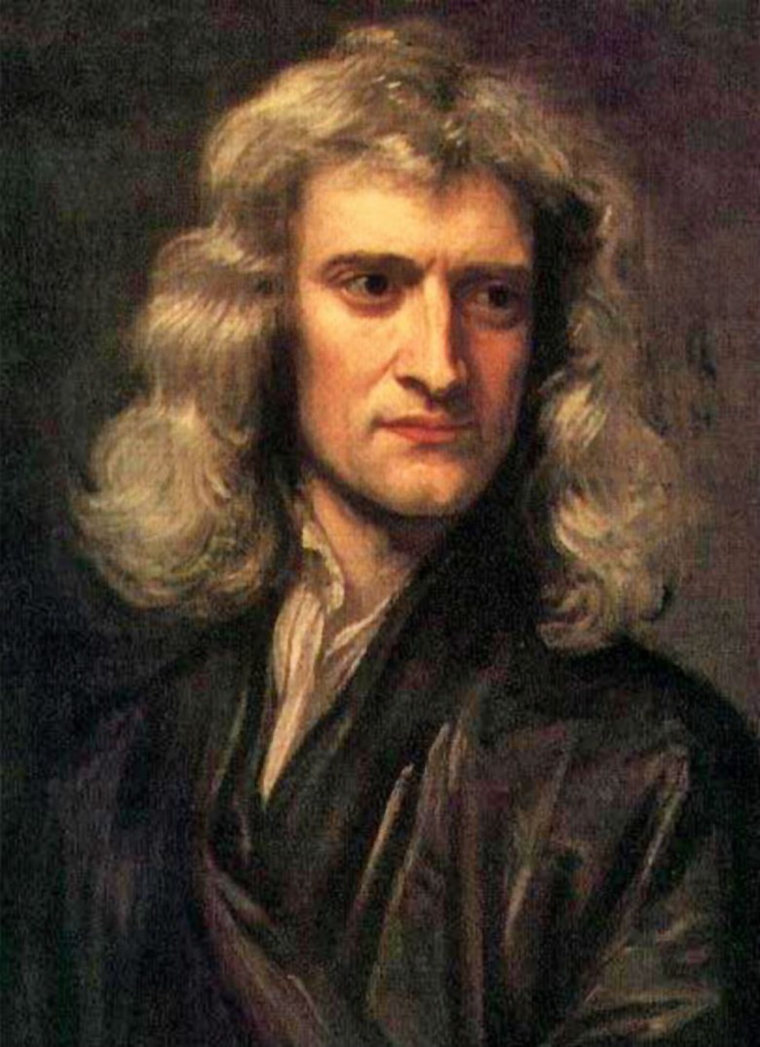
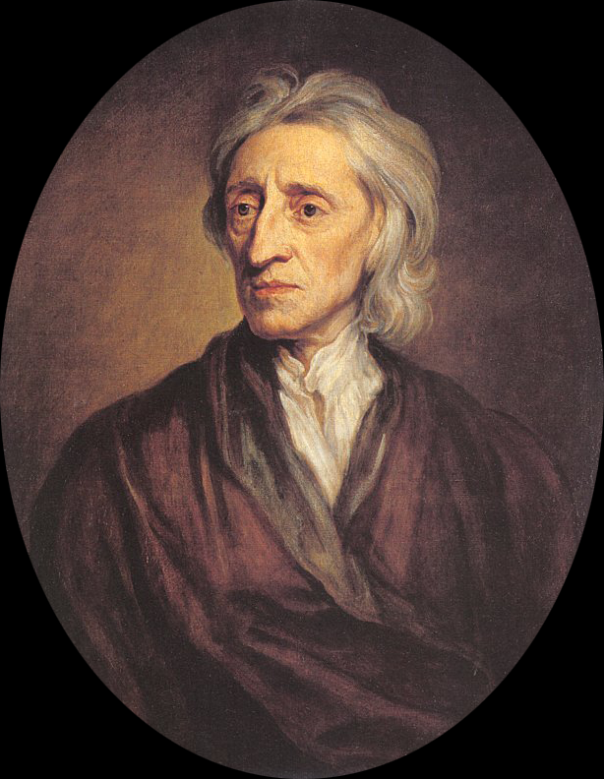
Sir Isaac Newton (English, 1642 – 1726), key figure in the Scientific Revolution, most famous for his Principia, which formulated the laws of motion and gravity
The Enlightenment Modern Thought and the Age of Revolutions
John Locke (English, 1632-1704), Enlightenment philosopher who promoted empiricism and democratic rule.

Slide 12
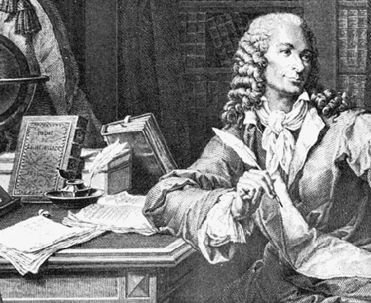
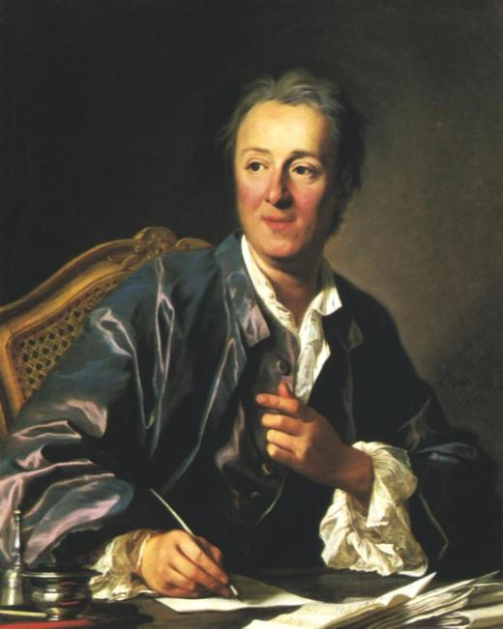
The Enlightenment 18th century French Philosophes – the power of the pen
Denis Diderot (1713-1784)
created the first encyclopedia
to promote democratization
of knowledge.
Voltaire (Francois Marie Arouet,1694-1778) – attacked both state and church of the “old regime.”

Slide 13
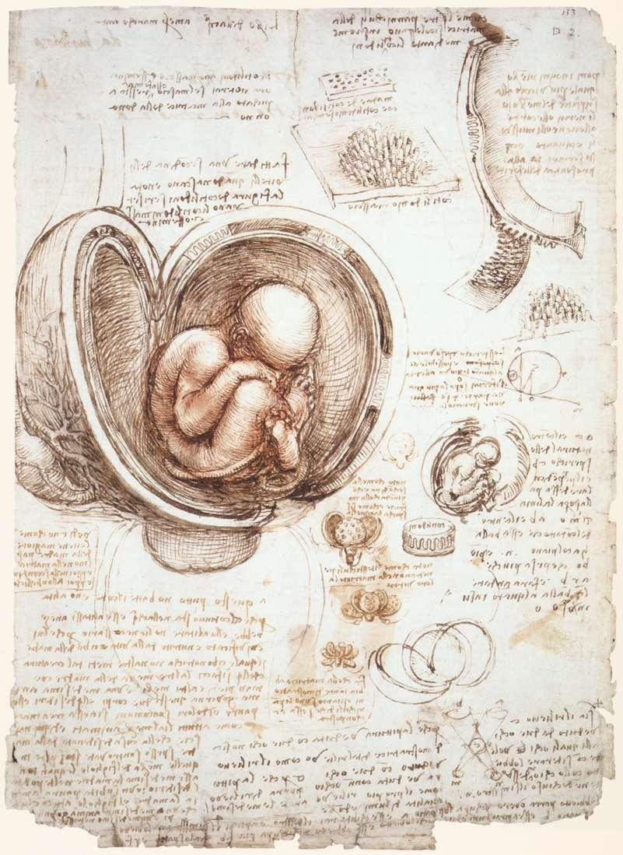
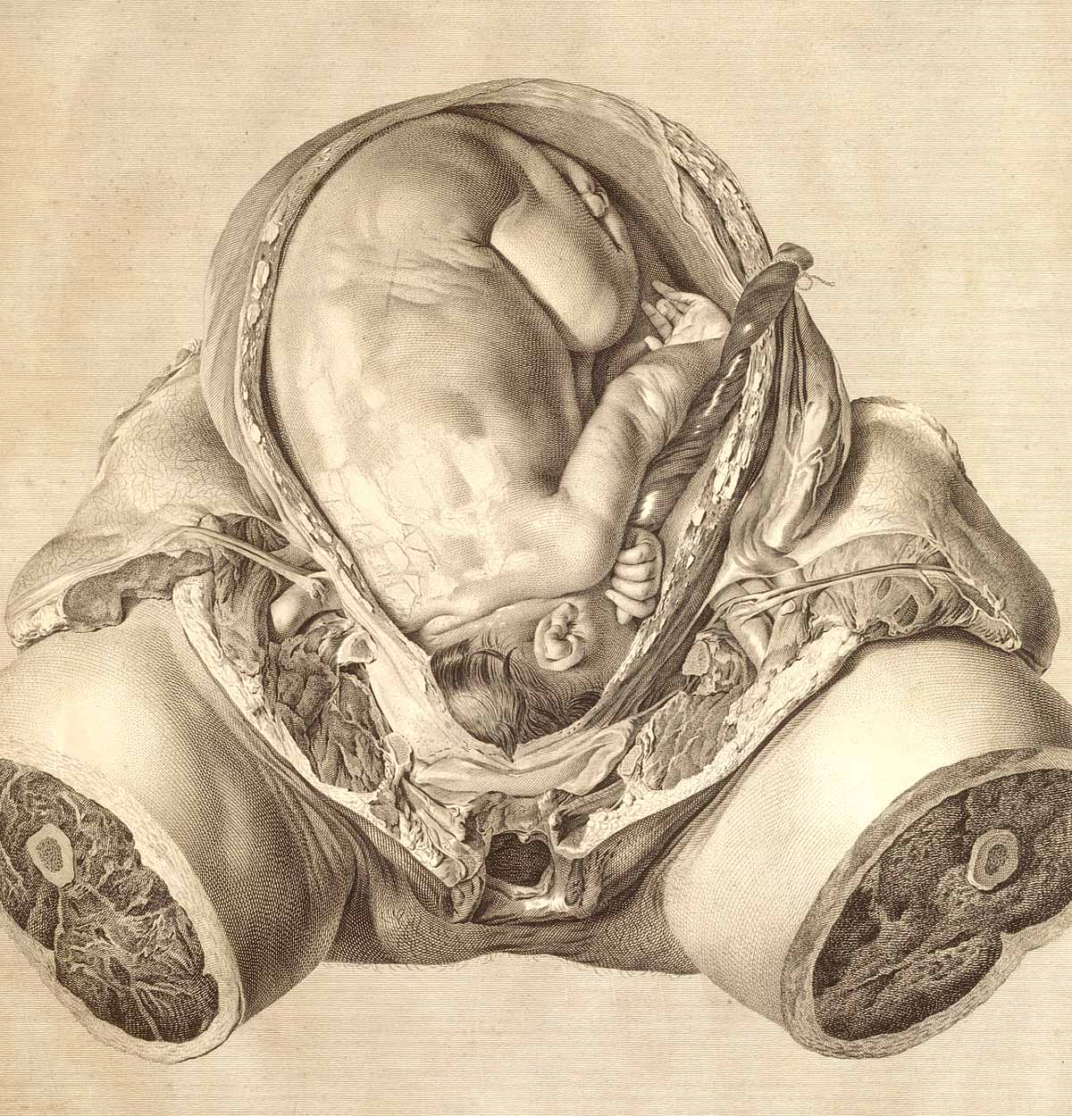
William Hunter (English, 1718-1783) Child in Womb, from The Anatomy of the Human Gravid Uterus, Birmingham, 1774, Copperplate engraving, National Library of Medicine, London. Empiricism – merger of science and art
Leonardo da Vinci, Fetus and Lining of the Uterus, 1511-13, chalk with pen and ink. High Renaissance empiricism and mimesis, merger of art and science

Slide 14
JOSEPH WRIGHT OF DERBY (English painter, 1734-1797), A Philosopher Giving a Lecture at the Orrery (in which a lamp is put in place of the sun), ca. 1763–1765. Oil on canvas, 4’ 10” x 6’ 8”. Derby Museums and Art Gallery, Derby, Derbyshire, England. EMPIRICISM – ENLIGHTENMENT SCIENCE AND REASON

Slide 15
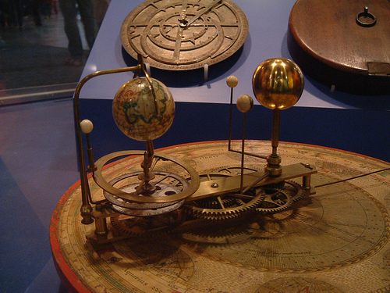
A small orrery from the mid-18th
century. Solar system as a clock: emblematic of secular rationalism and empiricism.
JOSEPH WRIGHT OF DERBY, A Philosopher Giving a Lecture at the Orrery ca. 1763–1765

Slide 16
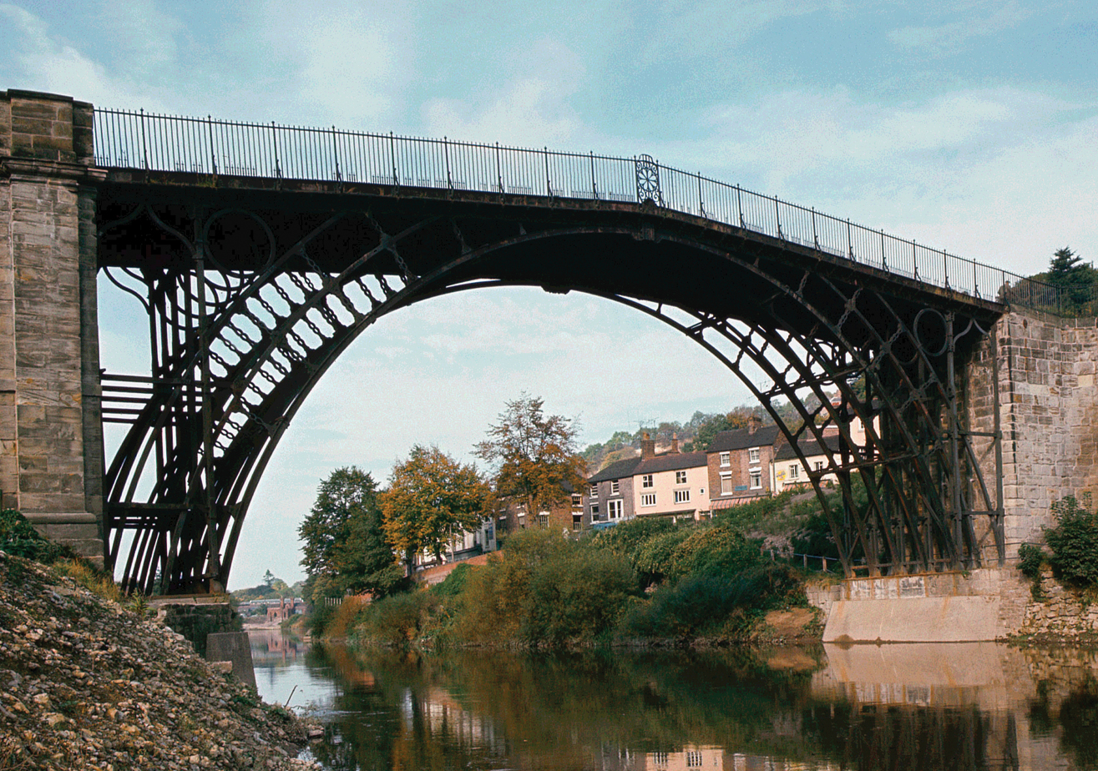
ABRAHAM DARBY (English iron master, 1750-1789) and THOMAS PRITCHARD (English architect, 1723-1777), iron bridge at Coalbrookdale, England, 1776–1779. 100’ span, 800 cast iron parts. It is the first cast iron bridge in the world, a monument of the industrial revolution. “Doctrine of progress”

Slide 17
Neo-Classicism and Revolution
From the Late 18th Century in Europe

Slide 18
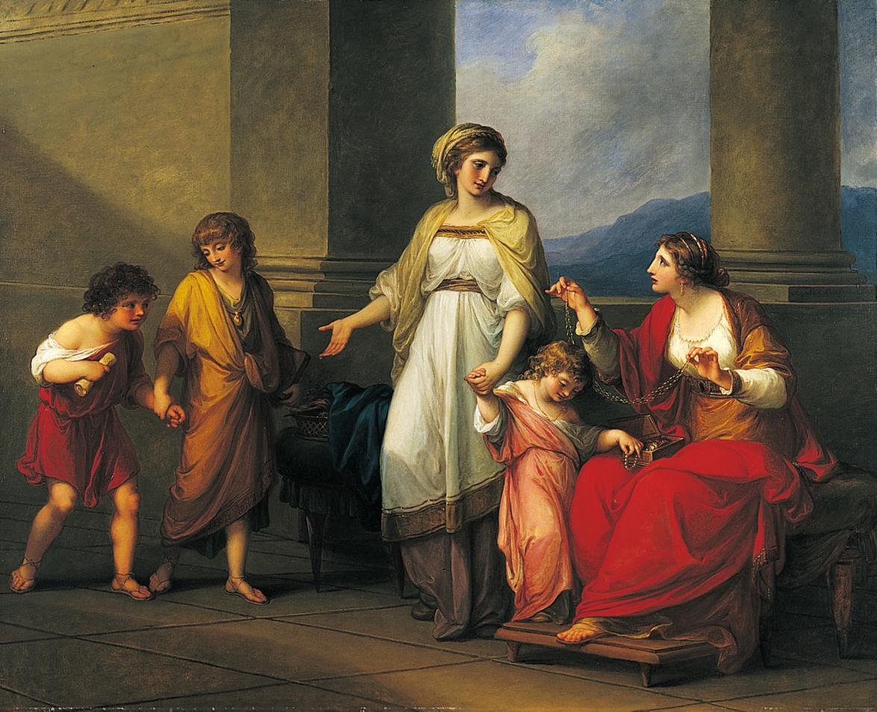
ANGELICA KAUFFMANN (Swiss-Austrian active in London, 1741-1807) Cornelia Presenting Her Children as Her Treasures, or Mother of the Gracchi, ca. 1785. Oil on canvas, 3’ 4” x 4’ 2”. NEOCLASSICISM

Slide 19
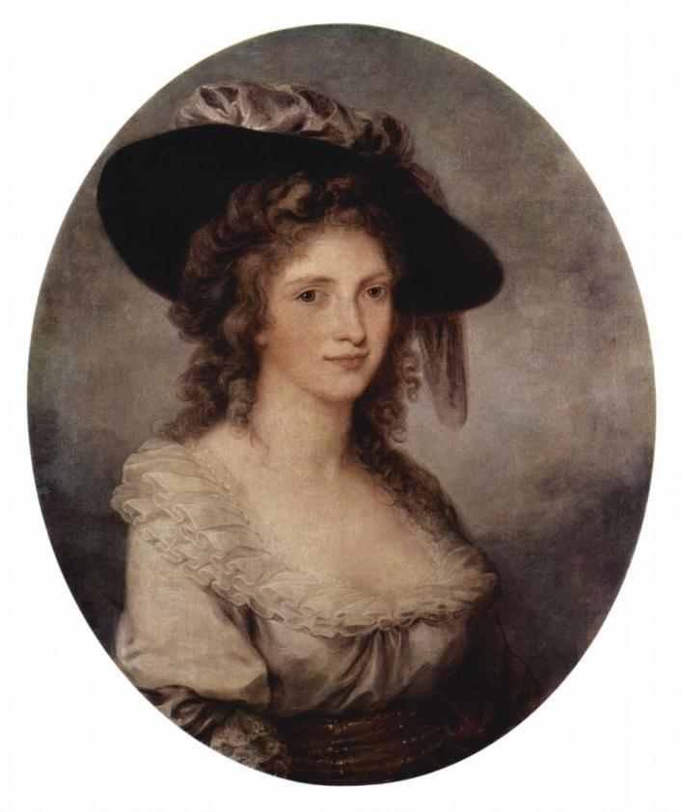
Angelica Kauffman, Self Portrait, 1780-85

Slide 20
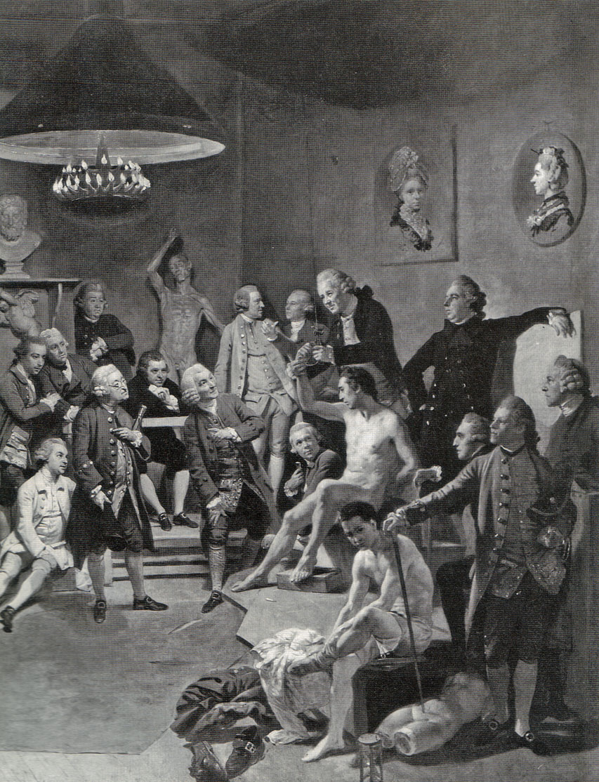
Johann Zoffany, The Academicians of the Royal Academy, 1771-72 (detail). The two women members of the British Royal Academy, Angelica Kauffman and Mary Moser are represented as paintings. After them no woman was admitted as a full member until 1936

Slide 21
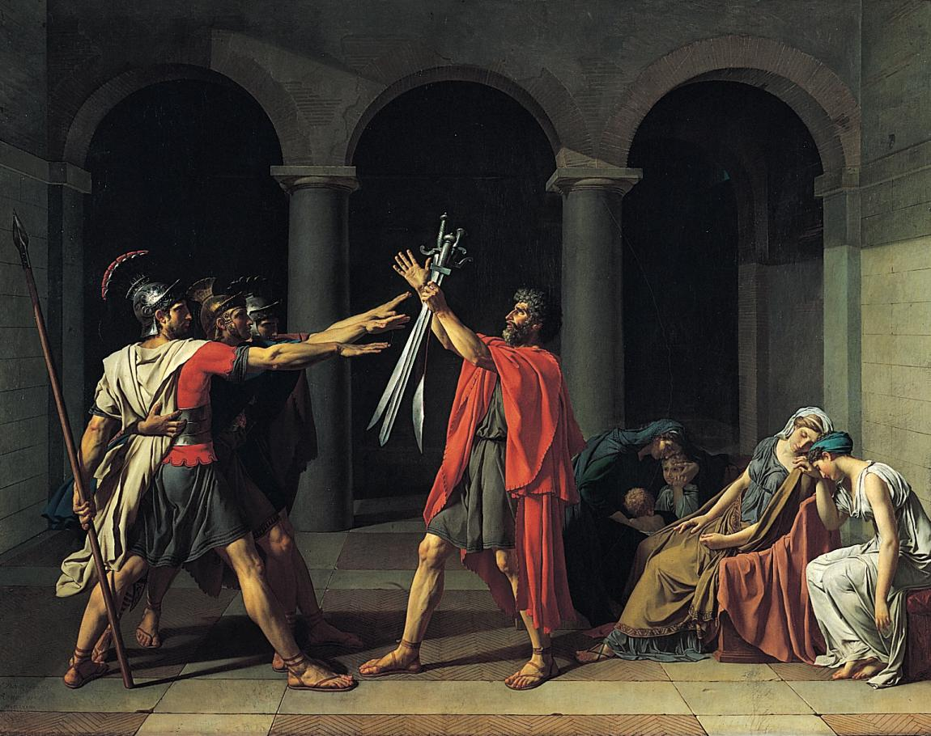
JACQUES-LOUIS DAVID (French, 1748-1825), Oath of the Horatii, 1784. Oil on canvas, approx. 11’ x 14’. Louvre, Paris. NEOCLASSICAL PAINTER-IDEOLOGIST of the French Revolution and the Napoleonic Empire

Slide 22
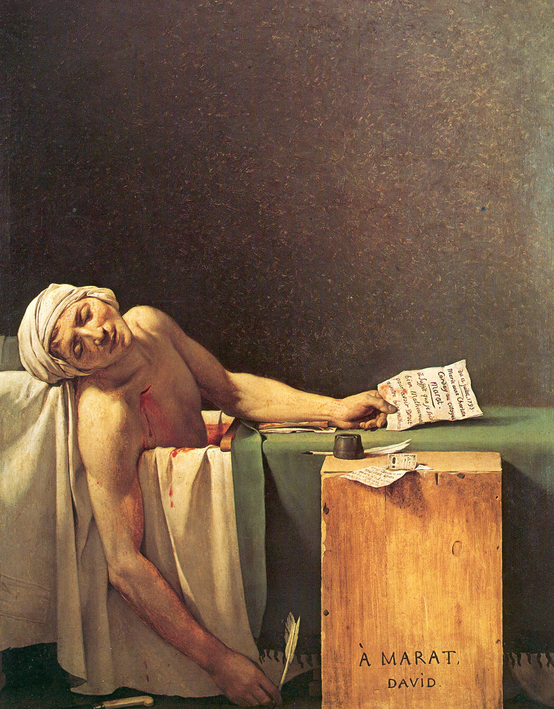
JACQUES-LOUIS DAVID, The Death of Marat, 1793. Oil on canvas, approx. 5’ 3” x 4’ 1”. Musées Royaux des Beaux-Arts de Belgique, Brussels. CURRENT EVENT
“Marks of heroism and
civic virtue offered the
eyes of the people [will]
electrify its soul, and plant
the seeds of glory and
devotion to the fatherland.”
- David

Slide 23
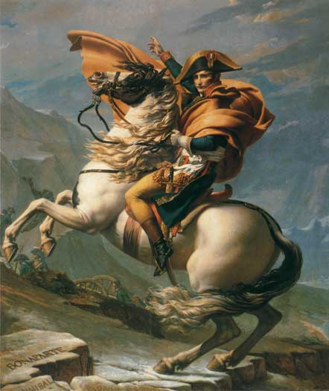
Jacques-Louis David, Bonaparte Crossing the St. Bernard Pass, 1800, Oil on canvas, 260 x 221 cm. In 1800, Napoleon led his army of 60,000 men across the alps to gain control of Italy. (Napoleon was probably on a mule.)

Slide 24
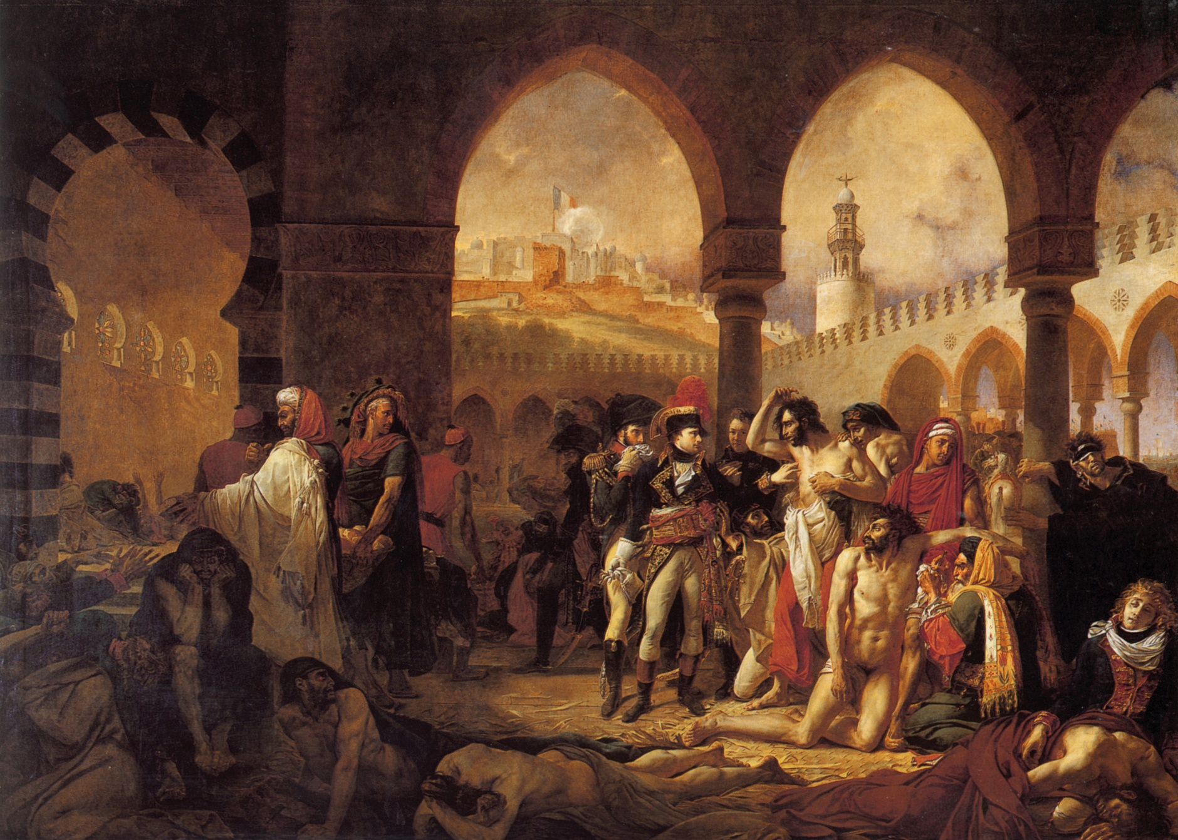
Antoine-Jean Gros (French 1771-1835), Napoleon at the Plague House at Jaffa, 1804, oil on canvas, 17’5” x 23’ 7”, Louvre Neoclassical-Romantic

Slide 25
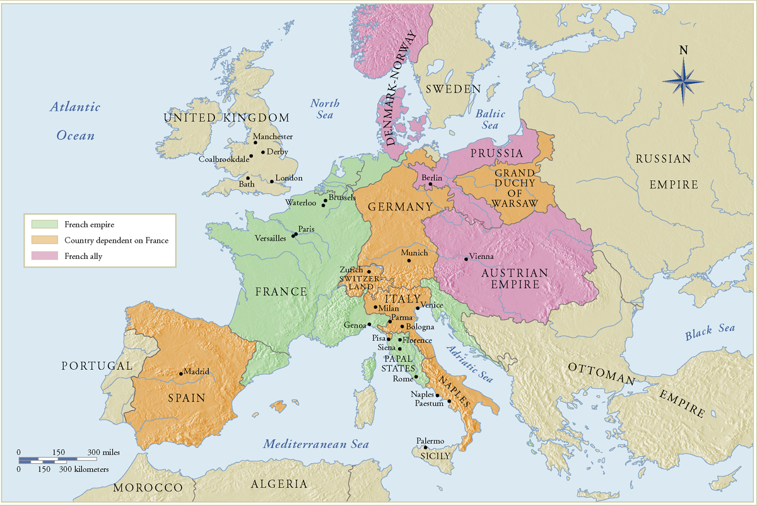
Napoleonic Europe 1800-1815

Slide 26
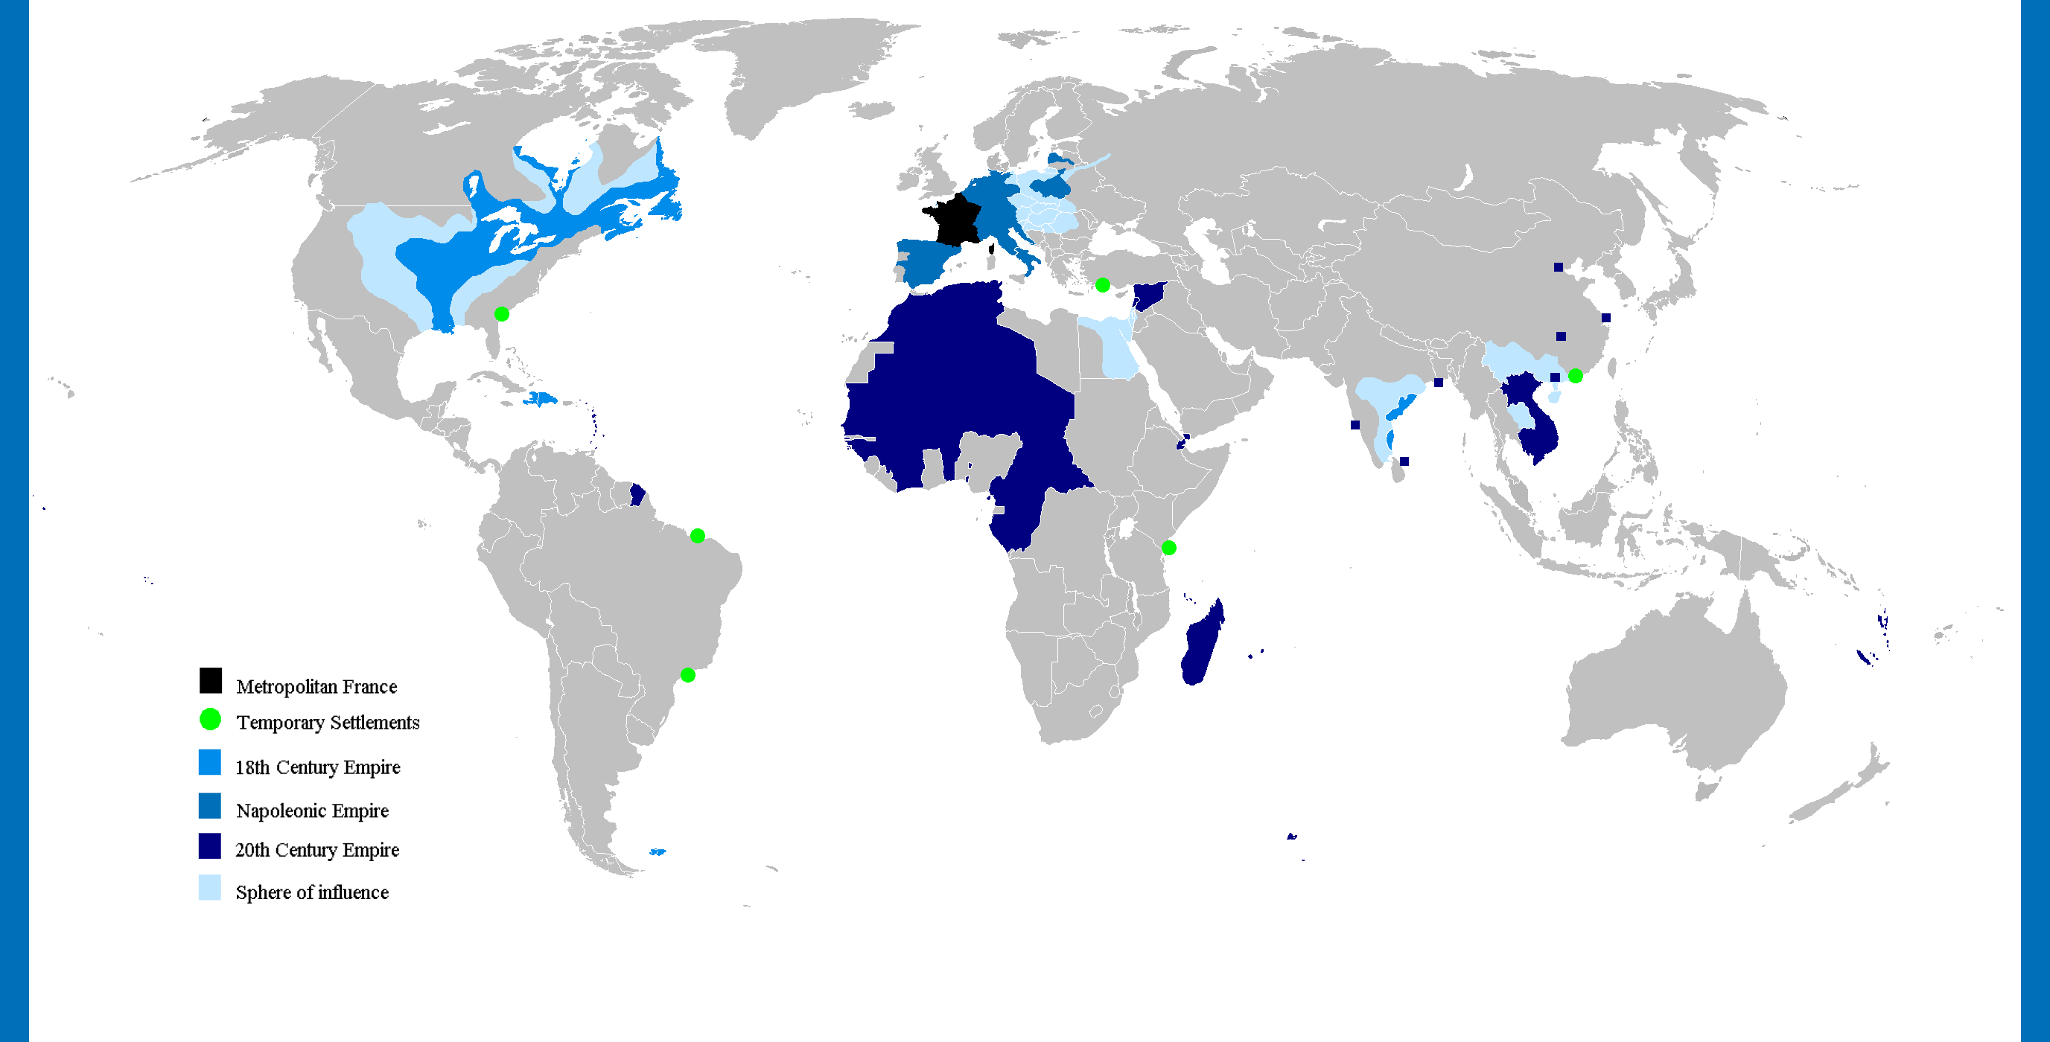

Slide 27
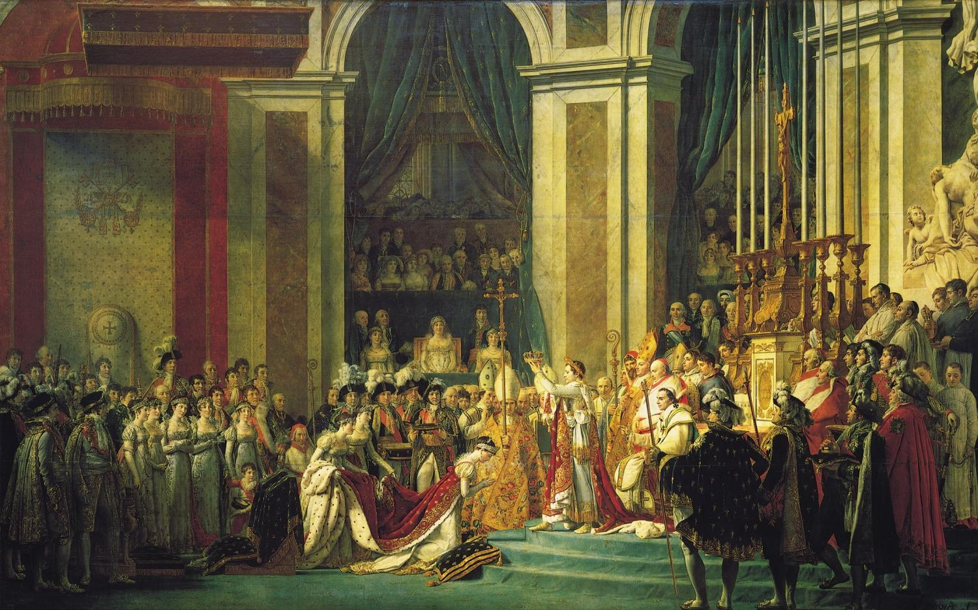
JACQUES-LOUIS DAVID, The Coronation of Napoleon, 1805–1808. Oil on canvas, 20’ 4 1/2” x 32’ 1 3/4”. Louvre, Paris Napoleon was emperor from 1804-1815

Slide 28
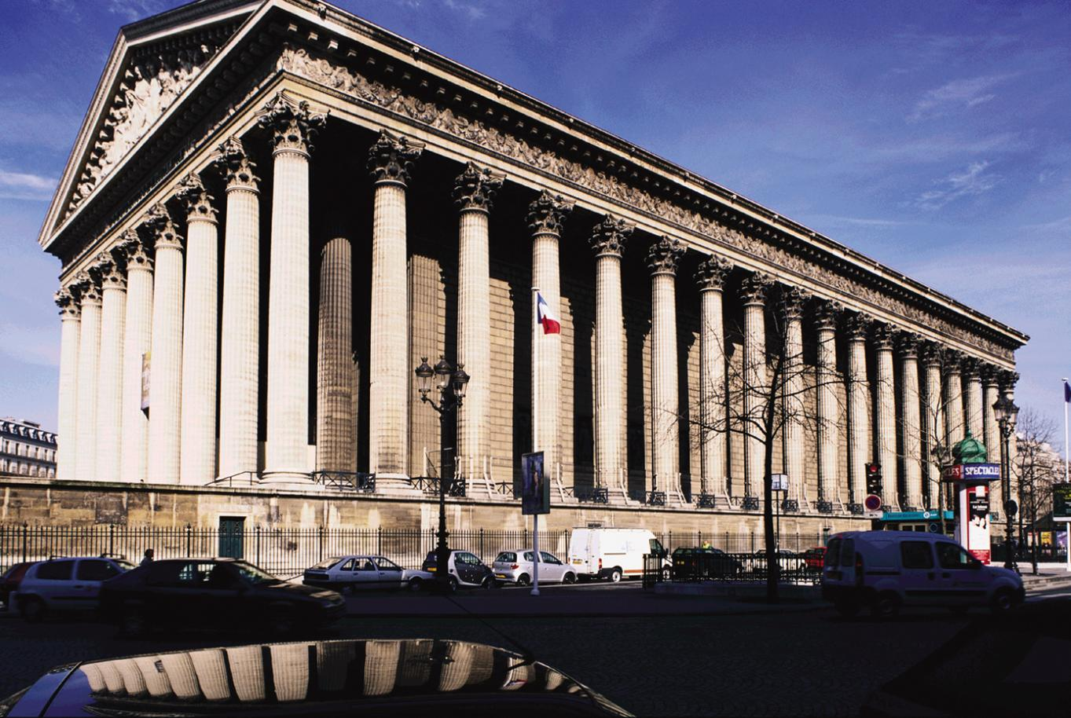
Pierre Vignon (French, 1763-1828) La Madeleine, Paris, France, “Symbolic link” between Rome and the Napoleonic empire. Begun as a church, it became a “temple of glory” for Napoleon’s armies and victories until the fall of Napoleon in 1815, when it became a Catholic church again. The 52 Corinthian columns are each 66 feet high.

Slide 29
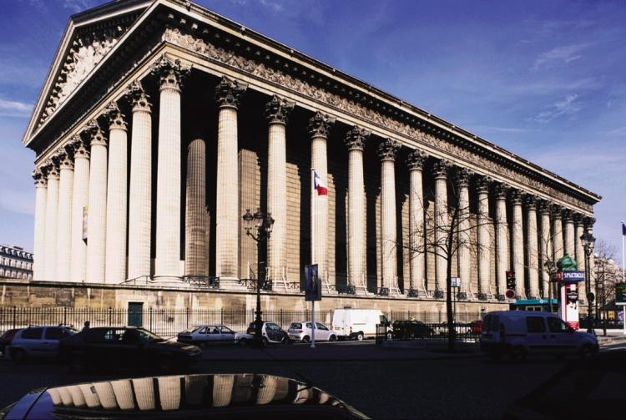
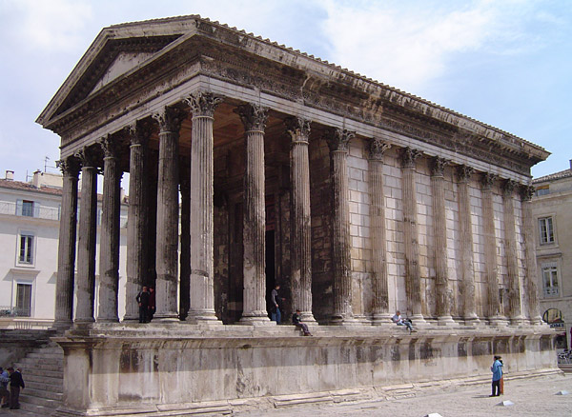
Compare (left) PIERRE VIGNON, La Madeleine, Paris, France, begun in 1807– completed in 1842 (right) the ancient Roman temple, Maison Carrée, Nimes, France, 19-16 BCE with
La Madeleine
Maison Carrée

Slide 30
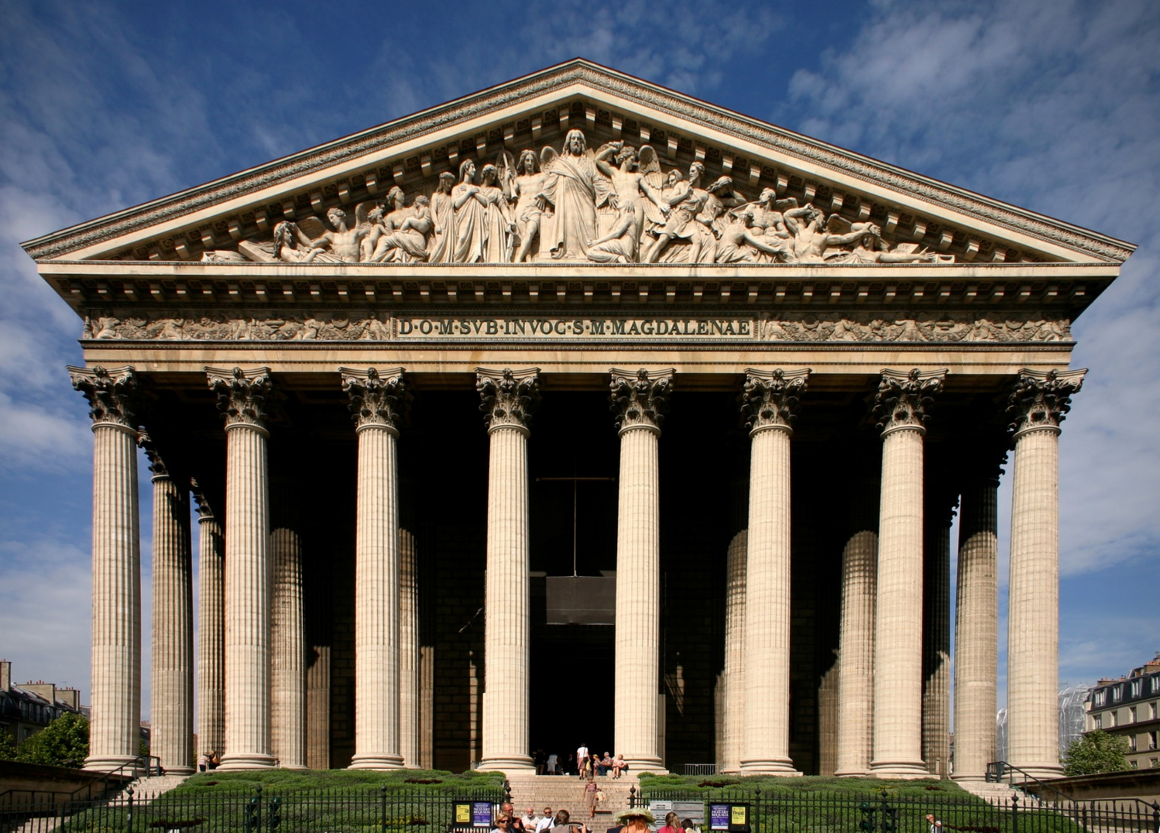
After Napoleon, Henri Lemaire was commissioned to create the Last Judgment pediment,
Church of La Madeleine, 1829-42, Paris. Bourbon Restoration.

Slide 31
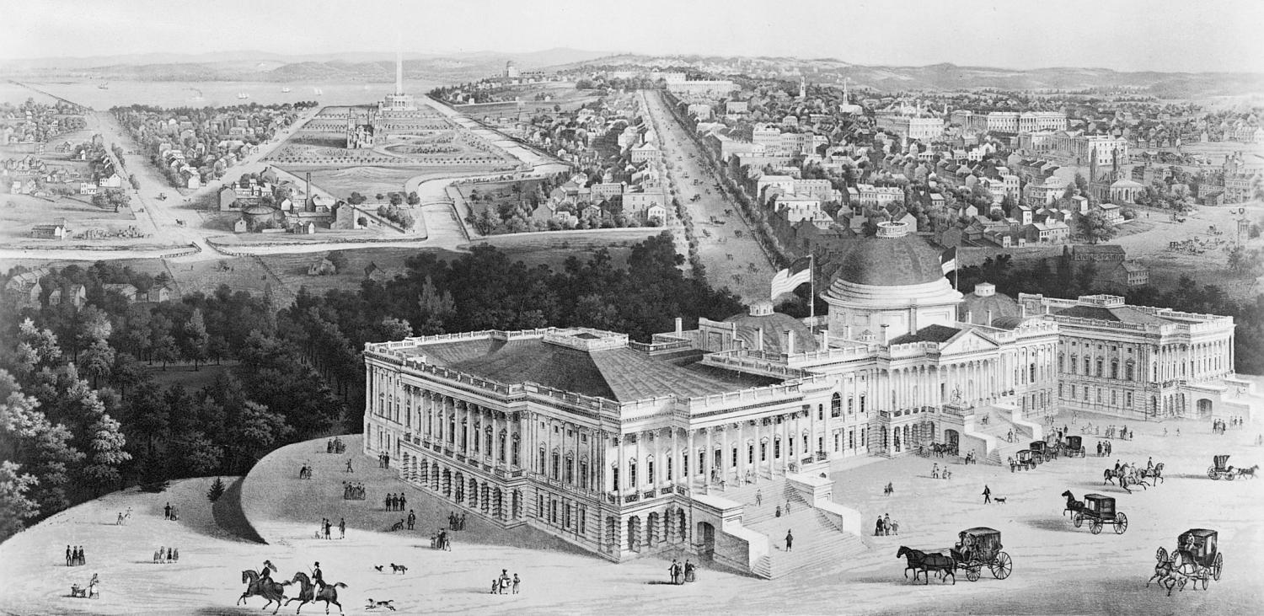
Drawing of Washington, D.C., 1852, showing Capitol building designed by BENJAMIN LATROBE (English-American, 1764 -1820), 1803–1807; and urban design (created in 1791) by PIERRE CHARLES L’ENFANT (French-American, 1754-1825) Neoclassicism and the New Rome (The USA)

Slide 32
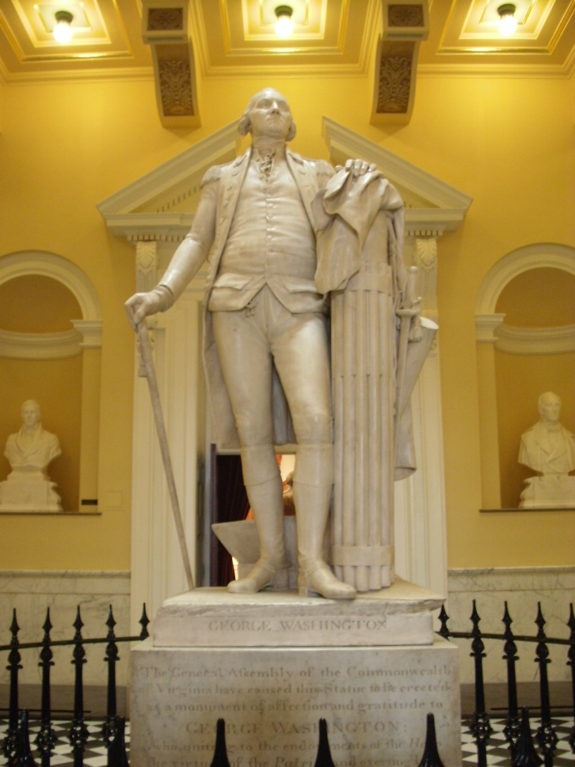
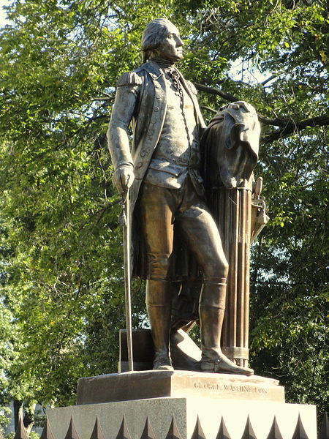
Jean-Antoine Houdon (French, 1732-1799), George Washington, 1788-1792, marble, 6’2” high, State Capitol, Richmond, Virginia. Roman fasces - with 13 rods symbolizing the 13 states - and Cincinnatus’s plow = Roman citizen soldier. Above: bronze copy in front of the North Carolina State Capitol in Raleigh

Slide 33
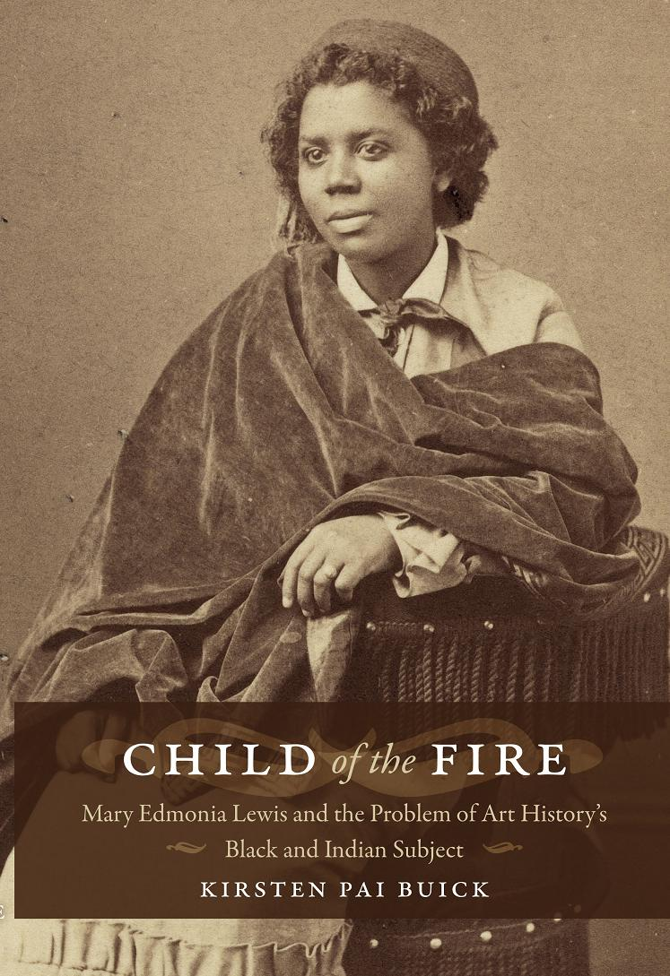
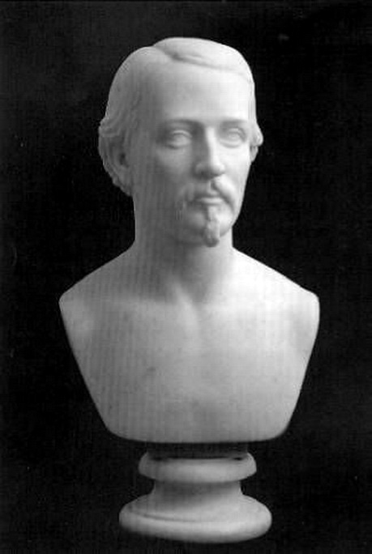
EDMONIA LEWIS (African-Ojibway American, Neoclassical sculptor, ca.1845-1911) Colonel Edward Gould Shaw, carved marble bust, 1864

Slide 34
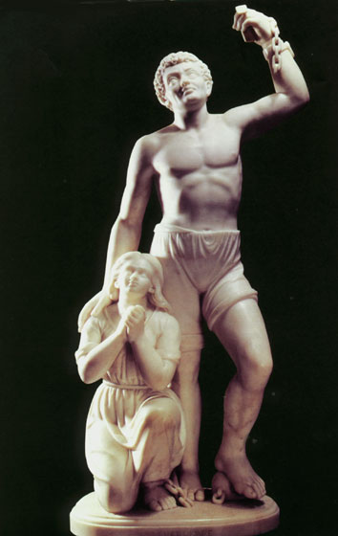
EDMONIA LEWIS, Forever Free, 1867. Marble, 3’ 5 1/4” x 11” x 7”. Howard University, Washington, D.C. Celebration of the “Emancipation Proclamation” issued by Lincoln on January 1, 1863, which declared "that all persons held as slaves" within the rebellious states "are, and henceforward shall be free.“ The U.S. Civil War lasted from 1861- 1865

Slide 35
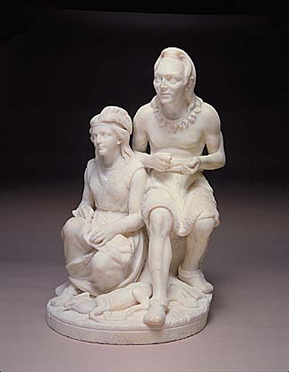
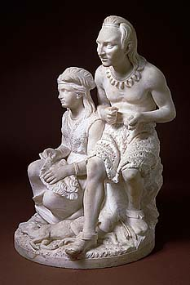
Edmonia Lewis, Old Arrow Maker, modeled 1866, carved 1872, marble, 21 1/2 x 13 5/8 x 13 3/8 inches. Inspired by Longfellow’s epic 1855 poem, “The Song of Hiawatha,” Minnehaha (with European features) is shown "plaiting mats of flags and rushes" and her father "making arrowheads of jasper.“ Hiawatha was Chippewa (Ojibway) like Edmonia Lewis. Neoclassicism
“That our tribes might be united
That old feuds might be forgotten
And old wounds be healed forever”

Slide 36
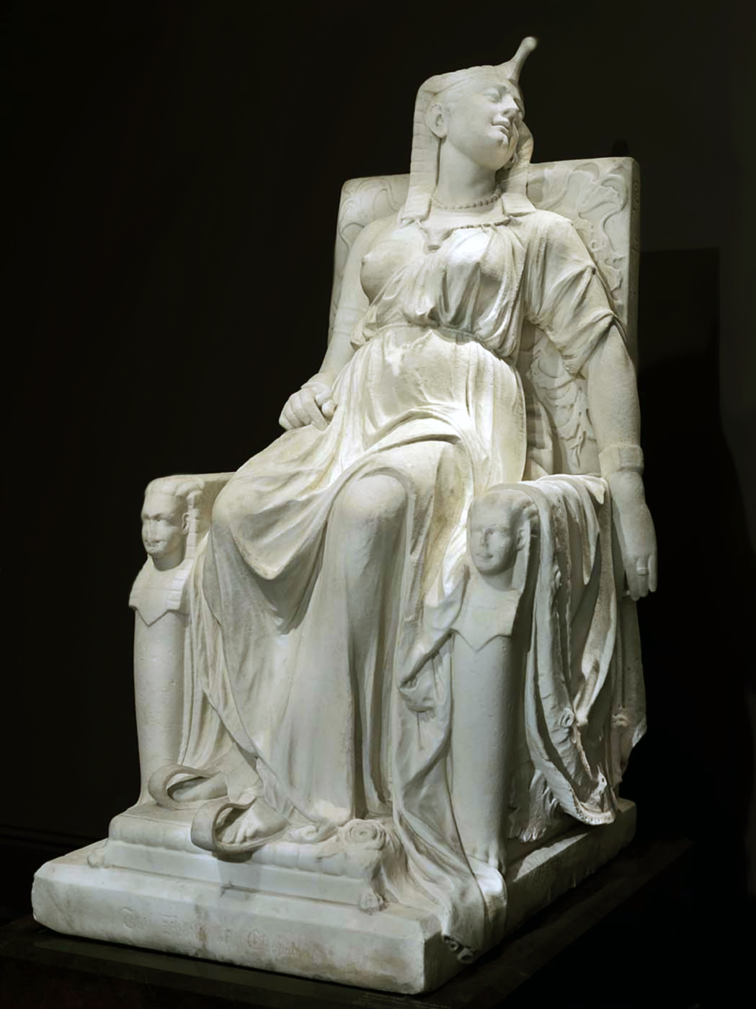
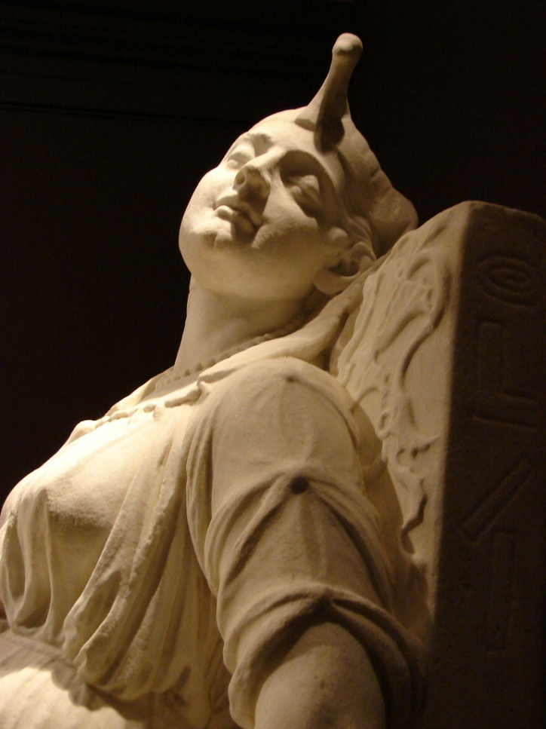
Edmonia Lewis, The Death of Cleopatra, 1876, marble, 63 x 31 1/4 x 46 inches, National Museum of American Art, Smithsonian Institution, Washington, D.C. Drew huge crowds at the1876 Centennial Exposition in Philadelphia

